Slide 1
Chapter 3: Input/Output

Slide 2
Objectives
In this chapter, you will:
Learn what a stream is and examine input and output streams
Explore how to read data from the standard input device
Learn how to use predefined functions in a program
Explore how to use the input stream functions get, ignore, putback, and peek

Slide 3
Objectives (cont’d.)
Become familiar with input failure
Learn how to write data to the standard output device
Discover how to use manipulators in a program to format output
Learn how to perform input and output operations with the string data type
Learn how to debug logic errors
Become familiar with file input and output

Slide 4
I/O Streams and Standard I/O Devices
I/O: sequence of bytes (stream of bytes) from source to destination
Bytes are usually characters, unless program requires other types of information
Stream: sequence of characters from source to destination
Input stream: sequence of characters from an input device to the computer
Output stream: sequence of characters from the computer to an output device

Slide 5
I/O Streams and Standard I/O Devices (cont’d.)
Use iostream header file to receive data from keyboard and send output to the screen
Contains definitions of two data types:
istream: input stream
ostream: output stream
Has two variables:
cin: stands for common input
cout: stands for common output

Slide 6
I/O Streams and Standard I/O Devices (cont’d.)
Variable declaration is similar to:
istream cin;
ostream cout;
To use cin and cout, the preprocessor directive #include <iostream> must be used
Input stream variables: type istream
Output stream variables: type ostream

Slide 7

cin and the Extraction Operator >>
The syntax of an input statement using cin and the extraction operator >> is:
The extraction operator >> is binary
Left-side operand is an input stream variable
Example: cin
Right-side operand is a variable

Slide 8
cin and the Extraction Operator >> (cont’d.)
No difference between a single cin with multiple variables and multiple cin statements with one variable
When scanning, >> skips all whitespace
Blanks and certain nonprintable characters
>> distinguishes between character 2 and number 2 by the right-side operand of >>
If type char or int (or double), the 2 is treated as a character or as a number 2

Slide 9
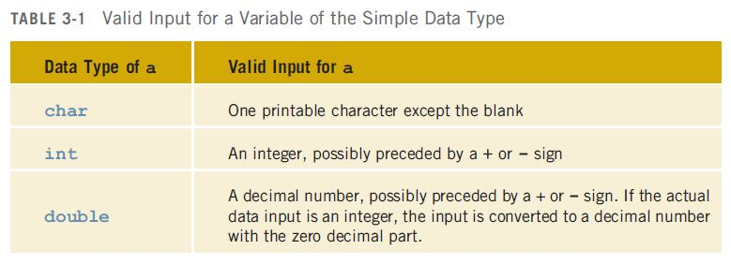
cin and the Extraction Operator >> (cont’d.)
Entering a char value into an int or double variable causes serious errors, called input failure

Slide 10
cin and the Extraction Operator >> (cont’d.)
When reading data into a char variable
>> skips leading whitespace, finds and stores only the next character
Reading stops after a single character
To read data into an int or double variable
>> skips leading whitespace, reads + or - sign (if any), reads the digits (including decimal)
Reading stops on whitespace non-digit character

Slide 11
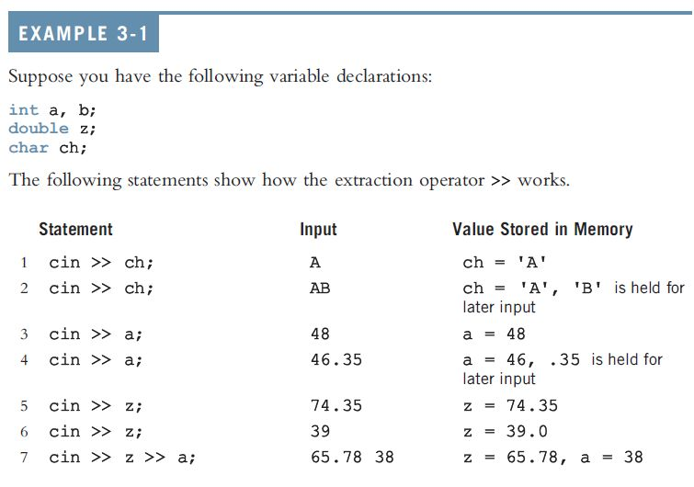

cin and the Extraction Operator >> (cont’d.)

Slide 12
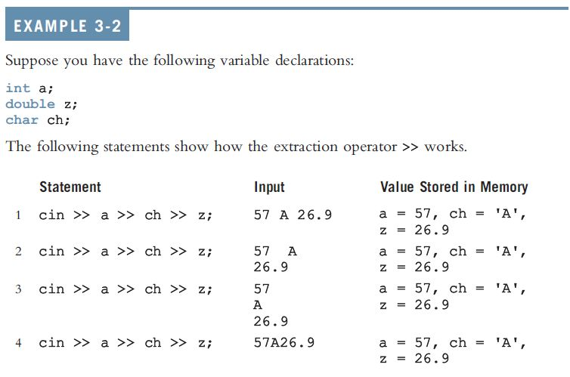
cin and the Extraction Operator >> (cont’d.)

Slide 13
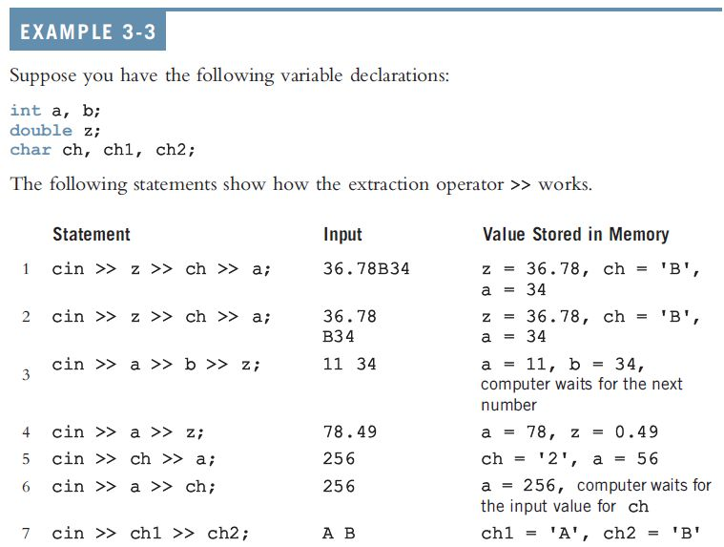
cin and the Extraction Operator >> (cont’d.)

Slide 14
Input statement
cin >> variable1 >> variable2 …;
It needs #include<iostream> preprocessor directive that contain istream cin ostream cout.
Example:-
1:-
cin>>Length>>width;
cin>>Length;
cin>>width;
The Same
2:-
Statement
Data
Contents after input
cin>>i>>ch>>x; 25 A 16.9
i=25 ch=‘A’ x=16.9
3:-
cin>>i>>j>>x; 12 8 i=12 j=8 (computer wait for the third number)
4:-
cin>>i>>x; 46 32.4 15 i=46 j=32.4 (15 is held for later input)
New line character ‘\n’ is considered one character
eg. cout<<“Hello!\n”;
cout<<“Hello!”<<endl;
The Same

Slide 15
Using Predefined Functions in a Program
Function (subprogram): set of instructions
When activated, it accomplishes a task
main executes when a program is run
Other functions execute only when called
C++ includes a wealth of functions
Predefined functions are organized as a collection of libraries called header files

Slide 16
Using Predefined Functions in a Program (cont’d.)
Header file may contain several functions
To use a predefined function, you need the name of the appropriate header file
You also need to know:
Function name
Number of parameters required
Type of each parameter
What the function is going to do

Slide 17
Using Predefined Functions in a Program (cont’d.)
To use pow (power), include cmath
Two numeric parameters
Syntax: pow(x,y) = x^{y}
x and y are the arguments or parameters
In pow(2,3), the parameters are 2 and 3

Slide 18

cin and the get Function
The get function
Inputs next character (including whitespace)
Stores in memory location indicated by its argument
The syntax of cin and the get function:
varChar
Is a char variable
Is the argument (or parameter) of the function

Slide 19
Input statement (cont.)
Note :- can’t input SPACE character , the >> skips white space (blank) character.
cin.get() FUNCTION READS ONE CHARACTER FROM THE KEYBOARD (Does not skips space characters)
eg.
ch1=cin.get() R cin>>ch1
ch2= cin.get() ch2=cin.get()
ch3=cin.get() 1 cin>>ch3
Given input: R 1

Slide 20
The Dot Notation Between I/O Stream Variables and I/O Functions
A precaution
In the statement
cin.get(ch);
cin and get are two separate identifiers separated by a dot
Dot separates the input stream variable name from the member, or function, name
In C++, dot is the member access operator

Slide 21
Input Failure
Things can go wrong during execution
If input data does not match corresponding variables, program may run into problems
Trying to read a letter into an int or double variable will result in an input failure
If an error occurs when reading data
Input stream enters the fail state

Slide 22
Output and Formatting Output
Syntax of cout when used with <<
expression is evaluated
value is printed
manipulator is used to format the output
Example: endl

Slide 23
Output statement
cout << Constant | Variable | Expression <<Expr2…;
| means or
The Output
Example: Given ch=‘2’ and firstname=“Ali” and lastname=“Ahmad”
cout<<ch; 2
cout<<“ch=“<<2; ch=2
cout<<firstname<<” “<<lastname; Ali Ahmad
cout<<“Erorr#”<<ch; Error#2
cout<<“\”Hello!\” ”; “Hello!”
➔To print 2 words on separate lines use <<endl
Example:
cout<<“He ”;
cout<<“There”;
cout<<“Hi”<<endl;
cout<<“There”<<endl;
Hi There
Hi
There

Slide 24
C++ program development goes through six steps:
Phases of C++ Programs
Step1: Edit (using text editor to type, correct and save the program file).
Step2: preprocessor, automatically before compile, executes to include other text files in the file to be compiled.
Step3: Compile , the compiler translates the C++ code into machine language (also called object-code).
Step4: Link , it is linking any used functions that are defined elsewhere such as standard library functions, or private library for a group of programmers, linker, links the object code with the code for the missing functions to provide full code
Step5: Load, a program before executing , must be loaded into the main memory, loader does this task , loading code from disk.
Step6: Execute, the computer under the control of its CPU executes the program. Instruction by instruction.

Slide 25
illustration of C++ Program Phases
Editor
Program is created in
the editor and stored
on disk.
Disk
Phases of C++ Programs:
Edit
Preprocess
Compile
Link
Load
Execute
Preprocessor
Disk
Preprocessor program
processes the code.
Compiler
Compiler creates
object code and stores
it on disk.
Disk
Linker links the object
code with the libraries,
creates a.out and
stores it on disk
Linker
Disk
main
Memory
Loader
Loader puts program
in memory.
Disk
.
.
.
.
.
.
main
Memory
CPU
CPU takes each
instruction and
executes it, possibly
storing new data
values as the program
executes.
.
.
.
.
.
.

Slide 26
Structure of C++ program
Every C++ program must have a function named main. The programmer can choose to decompose the program into several parts (user-defined functions). Think of main as the master and the other functions are the servants.
The execution always starts with main.
Preprocessor Directive
#include <iostream.h>
int main( )
{
Declarations ;
Executable Statement_1 ;
Executable Statement_2 ;
:
Executable Statement_n ;
return 0;
}
Header file facilitate
I/O
Type of returned value
Marks the start of the
main function (program)
Returning 0 means
every things is OK
else(1,2,..) something
went wrong (Exit Status)
Marks the end of the
main function (program)

Slide 27
C++ Programming Examples
C++ language
Facilitates a structured and disciplined approach to computer program design
Following are several examples
The examples illustrate many important features of C++
Each example is analyzed one statement at a time.

Slide 28
1 // Fig. 1.2: fig01_02.cpp
Comments
Written between /* and */ or following a //.
Improve program readability and do not cause the computer to perform any action.
2 // A first program in C++
3 #include <iostream.h>
preprocessor directive
Message to the C++ preprocessor.
Lines beginning with # are preprocessor directives.
#include <iostream.h> tells the preprocessor to include the contents of the file <iostream.h>, which includes input/output operations (such as printing to the screen).
4
5 int main()
6 {
7 cout << "Welcome to C++!\n";
8
9 return 0; // indicate that program ended successfully
C++ programs contain one or more functions, one of which must be main
Parenthesis are used to indicate a function
int means that main "returns" an integer value.
10 }
Welcome to C++!
Prints the string of characters contained between the quotation marks.
The entire line, including cout, the << operator, the string "Welcome to C++!\n" and the semicolon (;), is called a statement.
All statements must end with a semicolon.
return is a way to exit a function from a function.
return 0, in this case, means that the program terminated normally.
A left brace { begins the body of every function and a right brace } ends it.

Slide 29
A Simple Program: Printing a Line of Text
cout
Standard output stream object
“Connected” to the screen
<<
Stream insertion operator
Value to the right of the operator (right operand) inserted into output stream (which is connected to the screen)
cout << “Welcome to C++!\n”;
\
Escape character
Indicates that a “special” character is to be output

Slide 30
A Simple Program: Printing a Line of Text
There are multiple ways to print text
Following are more examples

Slide 31
1 // Fig. 1.4: fig01_04.cpp
1. Load <iostream.h>
2. main
2.1 Print "Welcome"
2.2 Print "to C++!"
2.3 newline
2.4 exit (return 0)
Program Output
2 // Printing a line with multiple statements
3 #include <iostream.h>
4
5 int main()
6 {
7 cout << "Welcome ";
8 cout << "to C++!\n";
9
10 return 0; // indicate that program ended successfully
11 }
Welcome to C++!
Unless new line '\n' is specified, the text continues on the same line.

Slide 32
1 // Fig. 1.5: fig01_05.cpp
1. Load <iostream.h>
2. main
2.1 Print "Welcome"
2.2 newline
2.3 Print "to"
2.4 newline
2.5 newline
2.6 Print "C++!"
2.7 newline
2.8 exit (return 0)
Program Output
2 // Printing multiple lines with a single statement
3 #include <iostream.h>
4
5 int main()
6 {
7 cout << "Welcome\nto\n\nC++!\n";
8
9 return 0; // indicate that program ended successfully
10 }
Welcome
to
C++!
Multiple lines can be printed with one statement.

Slide 33
Another Program: Adding Two Integers
>> (stream extraction operator)
When used with cin, waits for the user to input a value and stores the value in the variable to the right of the operator
The user types a value, then presses the Enter (Return) key to send the data to the computer
Example:
int myVariable;
cin >> myVariable;
Waits for user input, then stores input in myVariable
= (assignment operator)
Assigns value to a variable
Binary operator (has two operands)
Example:
sum = variable1 + variable2;

Slide 34
1 // Fig. 1.6: fig01_06.cpp
Load <iostream>
2. main
2.1 Initialize variables integer1, integer2, and sum
2.2 Print "Enter first integer"
2.2.1 Get input
2.3 Print "Enter second integer"
2.3.1 Get input
2.4 Add variables and put result into sum
2.5 Print "Sum is"
2.5.1 Output sum
2.6 exit (return 0)
Program Output
2 // Addition program
3 #include <iostream.h>
Notice how cin is used to get user input.
4
5 int main()
6 {
7 int integer1, integer2, sum; // declaration
8
9 cout << "Enter first integer\n"; // prompt
10 cin >> integer1; // read an integer
11 cout << "Enter second integer\n"; // prompt
12 cin >> integer2; // read an integer
13 sum = integer1 + integer2; // assignment of sum
14 cout << "Sum is " << sum << endl; // print sum
15
16 return 0; // indicate that program ended successfully
17 }
endl flushes the buffer and prints a newline.
Enter first integer
45
Enter second integer
72
Sum is 117
Variables can be output using
cout << variableName.

Slide 35
Good Programming practices
Keep it simple do not “stretch” the language.
Read C++ manual.
Experiment a feature by writing a simple program and test it.
Start your program with a comment to indicate what the program does?
Use new line \n to make output more organized.
Indent the body of each function one level, more indents for nesting.
Choose meaningful variables, constants and function names.
Use spaces after commas, operators and new lines between declaration and executable statement.
One statement per line.
Note: The function time(0) returns the current calendar time in seconds calculated from 1970.
It needs: #include<time.h> // turbo C++
#include<ctime> // Visual C++

Slide 36
Common programming Errors
Divide by zero.
Not including iostream for input/output operations.
Forgetting the (;) at end of each statement.
Using % with non-integer.
If a space found between the pair-of-symbols for the relational operators. (i.e., > = instead of >= ).
Confusing the equality == with the assignment =.
Reversing the order of the relational operators
(i.e., => isntead of >=).

Slide 37
Formatted Output
setw can be used to specify the width of the field that the next value of output will be printed in. To use it, you must include <iomanip.h> header file.
eg1:-
int num=12;
cout<< setw(4) << num; //num will be printed in a field width of 4 character.
eg2:-
int n1=12;
int n2=197;
cout<<setw(5)<< n1 << setw(6) << n2;
eg3:- (if the value is more than the specified setw value the compiler ignores the setw effect and print it with the minimum number of positions required.)
int num=1977;
cout<<setw(3)<<num;
1
2
1
2
1
9
7
1
9
7
7

Slide 38
Formatted Output(cont…1)
precision and setprecision for printing formatted floating point value
#include<iostream.h>
#include<iomanip.h>
#include<math.h>
int main( )
{
double root2=sqrt(2.0);
int places;
cout<<"square root of 2 with precision 0-9\n";
cout<<" using precision member function:\n";
for(places=0;places<=9;places++)
{
cout.precision(places);
cout << root2<<"\n";
}
cout<<"Using setprecision manipulator:\n";
for(places=0;places<=9;places++)
cout<<setprecision(places)<<root2<<"\n";
return 0;}
➔You may set the Number of Digits that appear on the right of the decimal-point the way you like it to be.
➔ it can be done by either setprecision stream manipulator, or precision member function.
eg. Using both to output the square root of 2

Slide 39
Formatted Output(cont…2)
Output
Square root of 2 with precision 0-9 using precision member function
1
1.4
1.41
1.414
1.4142
1.41421
1.414214
1.4142136
1.41421356
1.414213562
Using setprecision manipulator
1
1.4
1.41
1.414
1.4142
1.41421
1.414214
1.4142136
1.41421356
1.414213562

Slide 40
Summary
Use cin and stream extraction operator >> to input from the standard input device
Use cout and stream insertion operator << to output to the standard output device
Preprocessor commands are processed before the program goes through the compiler
A file containing a C++ program usually ends with the extension .cpp

